Slide 1
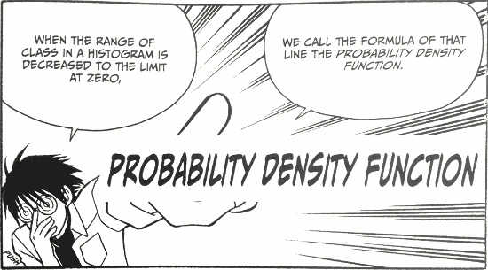
Normal Distribution
Dr. Abolfazl Saghafi
Assistant Professor of Statistics & Data Science
Data Science Program Director
Chapter 5 Part 1

Slide 2
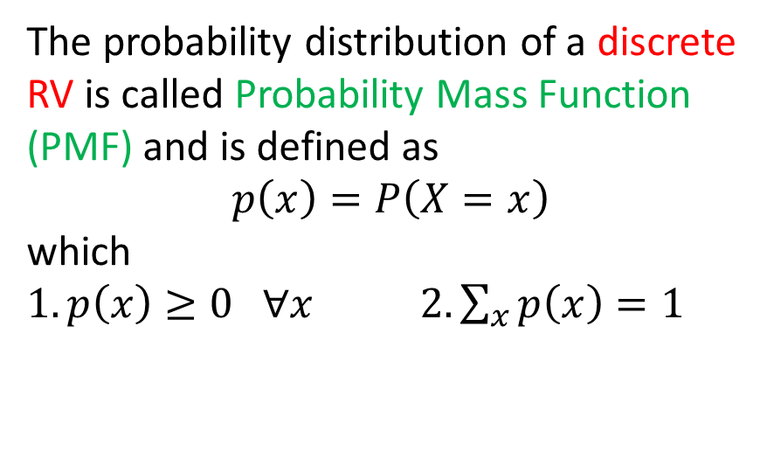

Discrete Vs Continuous Distributions
Discrete RV
where the support of random variable is a finite or countable.
Continuous RV
where the support of random variable is countless, usually an interval.
Ex1. Rx={0, 1, 2}
Ex2. Ry={1, 2, 3, …}
Ex3. Rx=[0, ∞)
Reminder
New
The probability distribution of a discrete RV is called Probability Mass Function (PMF) and is defined as
$$p\left(x\right)=P\left(X=x\right)$$
which
$1. p\left(x\right)≥0 ∀x$ $2. \sum_{x}{p\left(x\right)}=1$
The probability distribution of a continuous RV is called Probability Density Function (PDF) and is a function that has two properties
$$1.f\left(x\right)≥0 ∀x 2. \int_{−∞}^{+∞}{f\left(x\right) dx=1}$$
Notes:
As we saw earlier, a RV was called discrete, if it could take finite or countable number of values. If the range of RV was a countless number of values, we called it Continuous.
In case of discrete RV, we defined pmf. This function presented the mass that RV gives to its different values. The mass was a positive number which added to one for all the values.
Moving on to continuous case, here we have probability density function, or PDF for short, it is defined as a function, f(x), that satisfies two conditions, first it is positive for all the values of x, second, its integral is one over all the values of x.

Slide 3
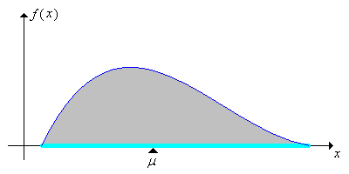
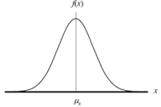
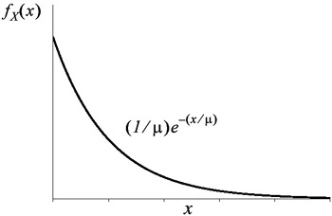

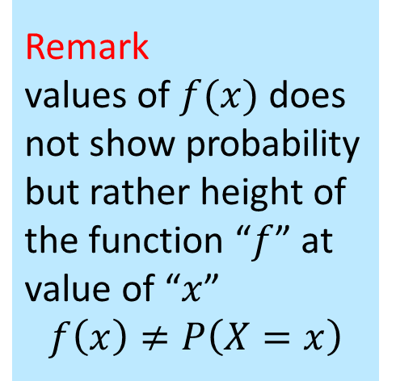
What TH is A PDF?
Remark
values of $f(x)$ does not show probability but rather height of the function “$f$” at value of “$x$”
$$f\left(x\right)≠P\left(X=x\right)$$
PMF and PDF capture the behavior of a RV and therefore the phenomenon that the RV explains. The three following PDFs are well-known in modeling chance of events in a simple system (lifetime of a lightbulb), complex systems (lifetime of a car or people), and random incidents (stock market price change).
For a continuous RV, probability of an event is defined as
$P\left(X∈A\right)=\int_{x∈A}{f\left(x\right) dx}$
Notes:
Here are examples of some pdf’s, on the top left we have a skewed to the right pdf, you can also see the expected value or mean of the distribution, top right is a triangular pdf, can someone tell me what is the expected value here?
Bottom left is the famous bell-shaped normal pdf, and bottom right is the exponential pdf
As you can see, all of the functions are positive, the graphs are above the x-axis, and their integral equals to 1.
And keep in mind, f(x) does not represent probability

Slide 4
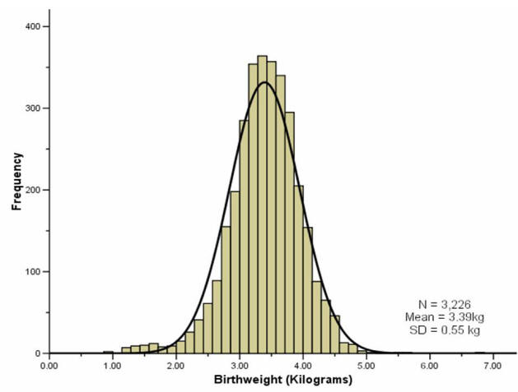
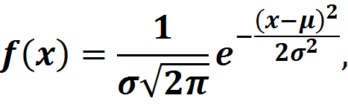



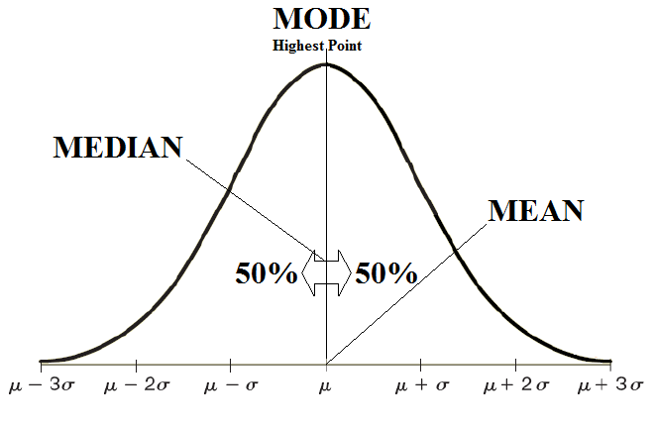
Normal Distribution
Given by the following PDF, the Normal or Gaussian distribution is the most important statistical distribution used to model many natural RANDOM phenomena.
Range of possible values
Center of the distribution
Spread of the distribution
We use the following notation to show that a RV has a specific normal distribution
X ~ N(μ, σ²)
Read as: RV X has a normal distribution with mean μ and variance σ²
Notes:
It has a bell-shaped figure, it is defined for values of x in real line, the shape of the distribution depends on two parameters, mu is the expected value or the mean, sigma square is the variance, a positive number

Slide 5
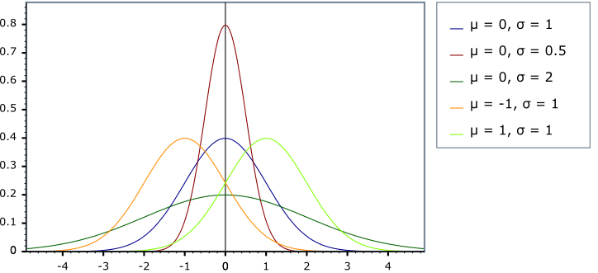
Normal Parameters (μ,σ²)
• μ controls the center of the normal curve
• As σ (or σ²) increases, the curve spreads out, as σ decreases, the curve becomes more peaked around μ

Slide 6
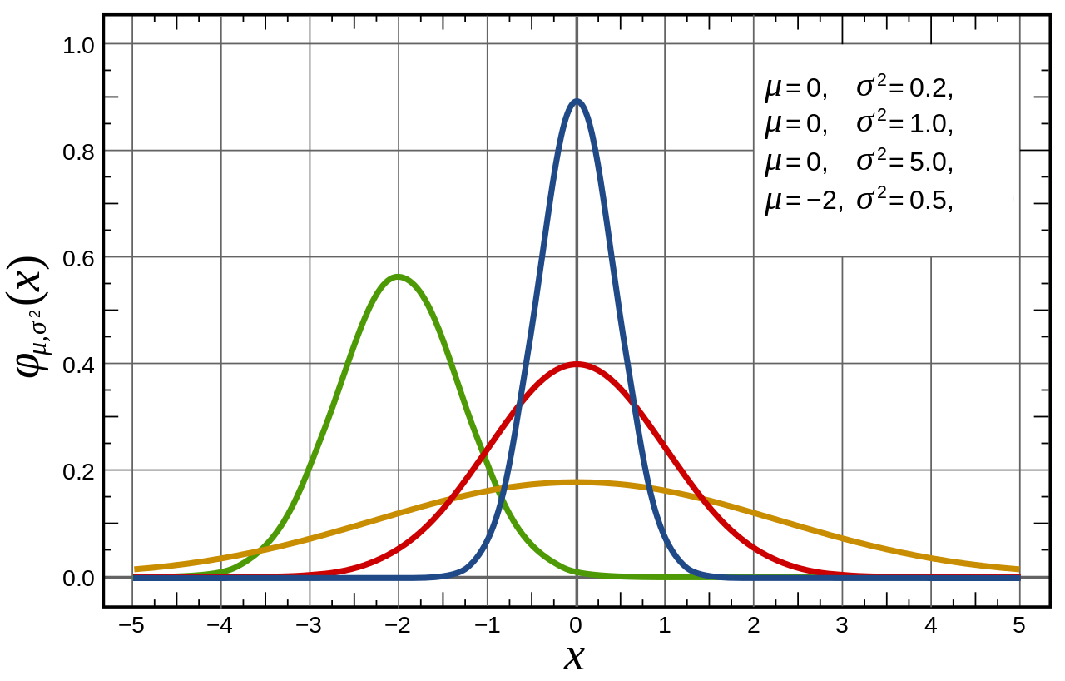
Example
Match each curve with the proper label showing its center and spread.
Notes:
Red: mu=0, sigma^2=1 this is the standard normal curve
Blue: mu=0, sigma^2=0.2 since it’s less spread than the red curve
Yellow: mu=0, sigma^2=5 since it’s more spread than the red curve
Green: your turn

Slide 7
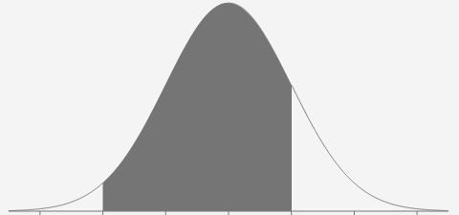
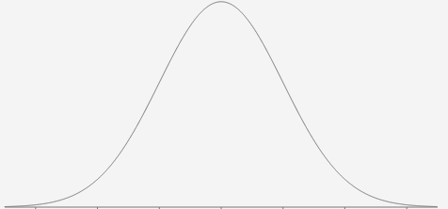
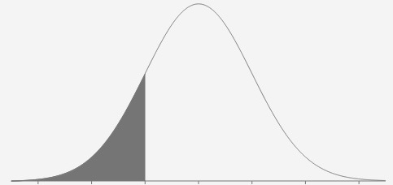
Probability
This is valid for ALL continuous distributions
a
b
a
a
For example, this curve could be the PDF of a random phenomenon like commute time (in minutes) from home to work. Above probabilities compute chance of commute time between [a, b], exactly a, less than or equal to a.
Notes:
Lets say the graph represents the pdf of RV X, then the probability that X takes values in the interval (a, b) is find by taking integral of f(x), the pdf, from a to b. The Integral computes that shaded area.
What does the shaded area on the top right represent?
Bottom right represents probability of X equal to a, which is integral of f(x) from a to a, by definition of integral it is equal to 0, since there is no area to compute
For this reason, these probabilities are all the same, no matter you include a or b in the interval, the probability wouldn’t change

Slide 8
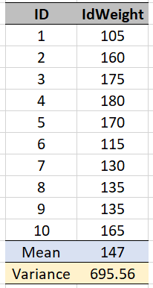
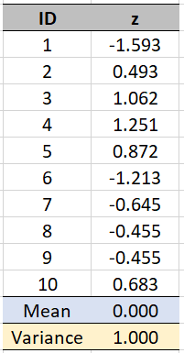
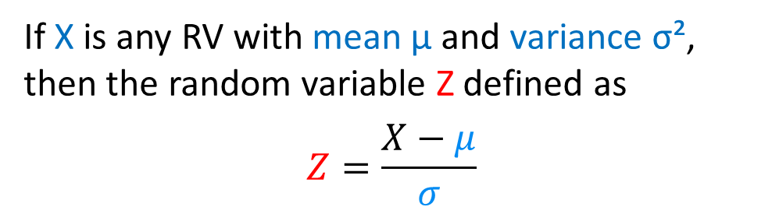
Standard Scores
Any RV with mean 0 and variance 1 is called standard RV.
If X is any RV with mean μ and variance σ², then the random variable Z defined as
$$Z=\frac{X−μ}{σ}$$
has a mean equal to 0 and variance equal to 1.
For example, the given data are the first 10 entries of variable “Ideal Weight” in a survey.
After standardization, the new data has a mean of 0 and variance of 1

Slide 9
Example
A student takes three tests graded as follows:
Scored 18 on test 1 while the class average and standard deviation were 16 and 6, respectively
Scores 44 on test 2 while the class average and standard deviation were 38 and 14, respectively
Scores 95 on test 3 while the class average and standard deviation were 87 and 36, respectively
Determine on which test the student scored the highest.
Notes:
Looking at these three grades you might say that the grade in the third test is higher, but the grades do not have the same scale at this point. We need to standardize them to put them in the same scale before comparing.
z1=(18-16)/6=0.33 z2=(44-38)/14=0.43 z3=(95-87)/36=0.22
Relatively speaking, the score on the second test falls further above the mean and is therefore the highest relative score.

Slide 10
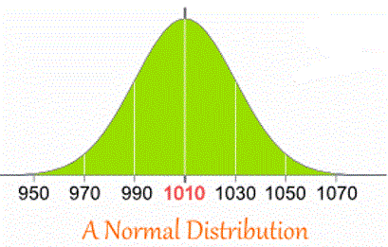
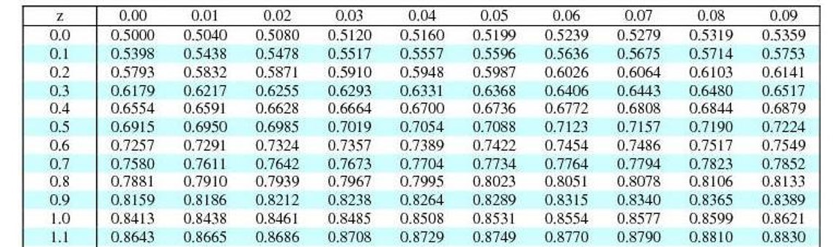

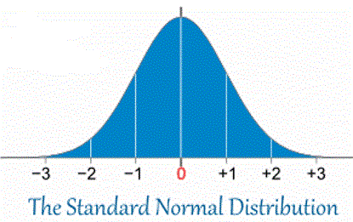
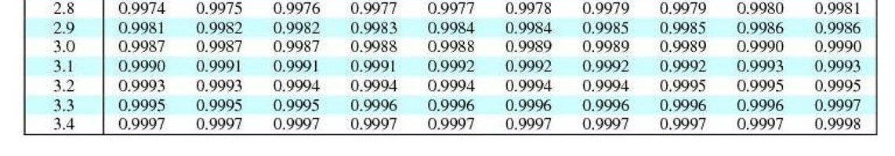


Normal Probability
In computing normal probabilities, if the distribution is not standard normal with μ=0 and σ=1, we standardize the distribution, then compute probabilities using normal tables OR calculator
$$f\left(x\right)$$
$$φ\left(z\right)$$
Notes:
The numbers on the first row and col of the table are values of z which could range from 0.00 to 3.49. The numbers within the table are approximate cumulative probability from -∞ up to z. For example, the first entry in the table is 0.5000 which is an approximation for P(Z≤0.00), the second number is 0.5040 which approximates P(Z≤0.01), …
Since the pdf is symmetric you can compute cumulative probability for negative values of z too.

Slide 11
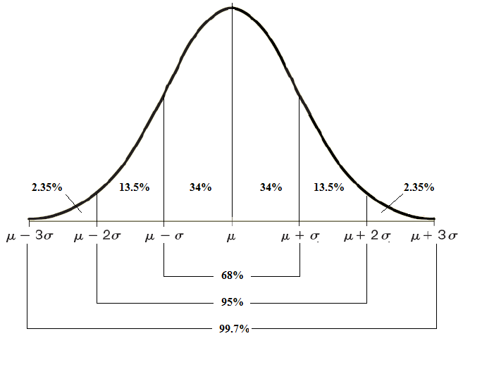
Empirical Rule
The total area under any normal curve from -∞ to +∞ always add up to 1
The following probabilities are fixed in any normal distribution. This is known as the Empirical rule
The portion of the area under the curve within a given interval represents the probability that the RV lie in that interval
$$P\left(μ−σ≤X≤μ+σ\right)=0.6827$$
$$P\left(μ−2σ≤X≤μ+2σ\right)=0.9545$$
$$P\left(μ−3σ≤X≤μ+3σ\right)=0.9973$$
Notes:
You can easily compute the probabilities using calculator, just follow standardization first
$$P\left(μ−σ≤X≤μ+σ\right)=P\left(−1≤\frac{X−μ}{σ}≤1\right)=P\left(−1≤Z≤1\right)=0.6827$$

Slide 12
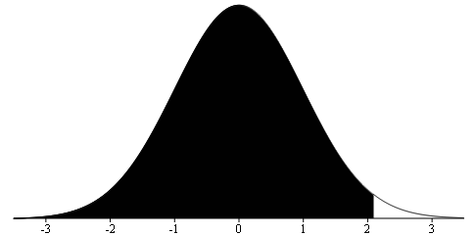
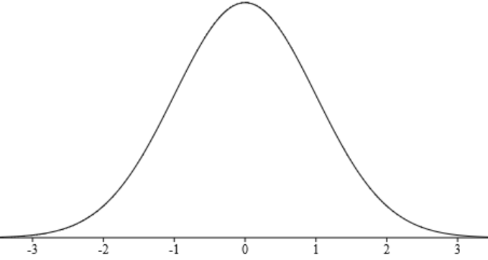
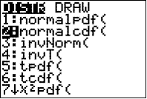
Using Calculator
Suppose RV Z ~ N(0, 1), compute the following normal probabilities.
0.9817
If asked for mean μ enter 0, for standard deviation σ enter 1
Press 2nd and VARS [DISTR]
Scroll down to
2:normalcdf(
Press ENTER
You can enter -99 instead of -∞ and 99 instead of +∞
Enter -99, 2.09, 0, 1)
and press ENTER
to get the answer
The syntax for computing probability in interval (a, b) that is P(a ≤ Z ≤ b) is normalcdf(a, b, μ, σ)

Slide 13
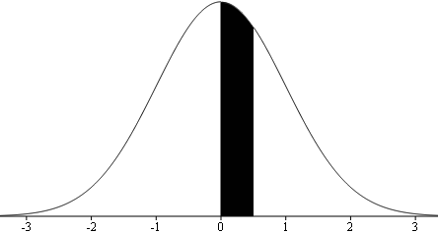
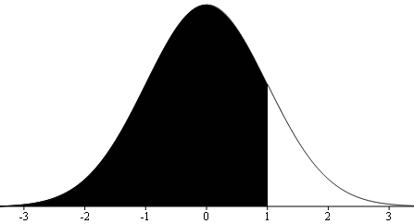
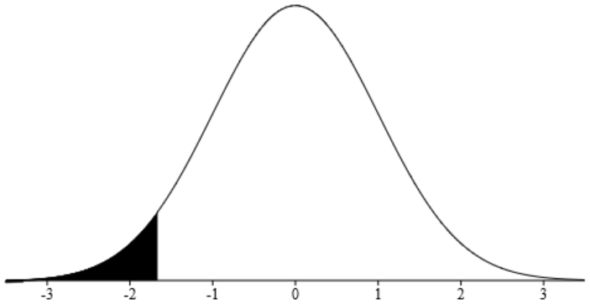
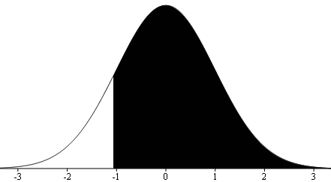
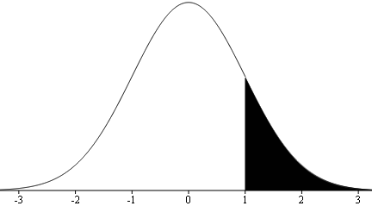
Standard Normal Examples
Compute the given standard normal probabilities
Notes:
Press 2nd and VARS [DISTR] Scroll down to 2:normalcdf( Press ENTER
Enter interval boundaries (a, b , 0, 1) Press ENTER
P(Z≤1)=0.8413 P(Z≤-1.67)=0.0475 P(Z>1)=0.1587 P(Z≥-1.06)=0.8554
P(0≤Z≤0.5)=0.1915
P(Z≥0)=0.5 since the curve is symmetric

Slide 14
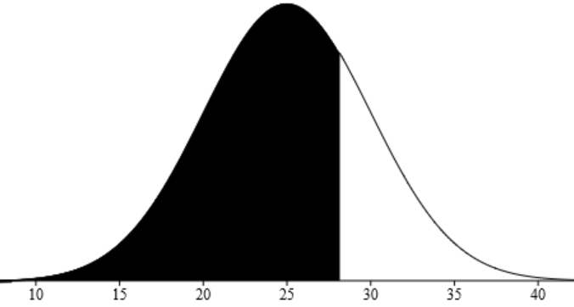
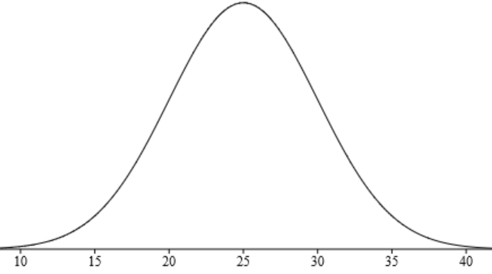



Normal Examples
• Use normal CDF function with given values of μ and σ and compute probability
• Show the answer in a standard normal graph
• Standardizing the given probability boundary helps you with better shading
For a Normal distribution with mean 25 and standard deviation 5, what is the probability that an observed data is at most 28.15?
$$X\sim N(μ=25,σ=5)$$
$$P\left(X≤28.15\right)$$
$$=normalcdf\left(−∞, 28.15, 25, 5\right)$$
$$=0.7357$$
Notes:
On your calculator, use
Press 2nd and VARS [DISTR] Scroll down to 2:normalcdf(
Press ENTER Enter -99,28.15,25,5) Press ENTER to get the answer
By standardizing the given interval, you’ll have the exact threshold for shading the standard normal curve

Slide 15
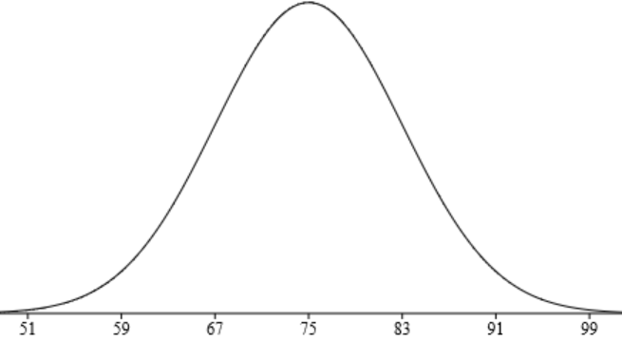
Example
Scores of a Statistics test are distributed normally with mean 75 and variance 64. If we select a student at random from the class, what is the probability that his/her grade is
a) Between 80 and 85
b) Less than or equal to 60
c) A+
d) How many students in a class of 50 are expected to score A+?
Random phenomenon here is
X: Stat test grades ~ N(μ=75, σ²=64)
Notes:
Although grades are random, they follow a pattern, a normal curve
Answer on the next page

Slide 16
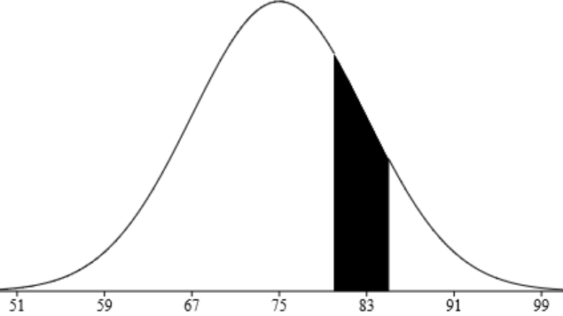
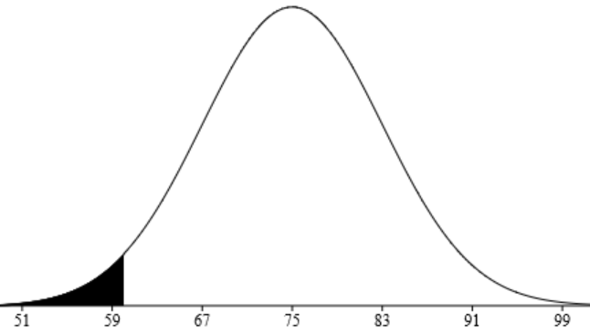






a) Between 80 and 85
$$P\left(80<X<85\right)$$
$$=normalcdf\left(80, 85, 75, 8\right)$$
$$=0.1587$$
b) Less than or equal to 60
$$P\left(X≤60\right)$$
$$=normalcdf\left(−∞, 60, 75, 8\right)$$
$$=0.0301$$
c) A+
d) How many students in a class of 150 are expected to score A+?
$$P\left(X≥96.5\right)$$
$$=normalcdf\left(96.5, ∞, 75, 8\right)$$
Y: # of students in a class 0f 150 who score A+
Y ~ Bin(150, 0.0036)
$$=0.0036$$
E(Y) = 150*0.0036= 0.54

Slide 17
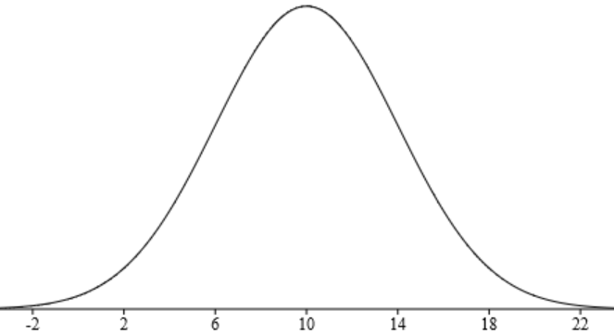
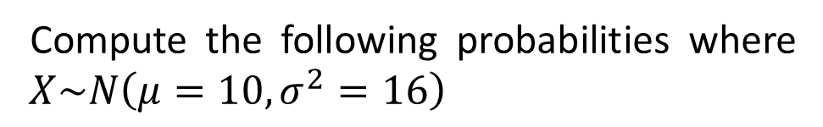



Question
Compute the following probabilities where $X\sim N\left(μ=10,σ^{2}=16\right)$
$$P\left(X≤14\right)$$
$$P\left(8≤X≤16\right)$$
$$P\left(X≥4\right)$$
Notes:
Use calculator with given values of μ and σ to compute probabilities, then highlight the answer on a normal curve. The correct answers are
0.8413 0.6247 0.9332

Slide 18
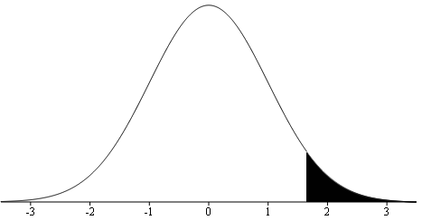
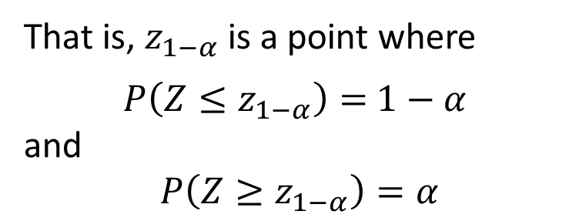

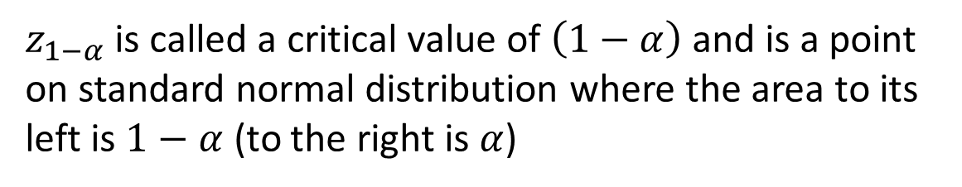
Critical Value
$z_{1−α}$ is called a critical value of $\left(1−α\right)$ and is a point on standard normal distribution where the area to its left is $1−α$ (to the right is $α$)
That is, $z_{1−α}$ is a point where
$P\left(Z≤z_{1−α}\right)=$ $1−α$
and
$P\left(Z≥z_{1−α}\right)=α$
1 - α
α
$$z_{1−α}$$

Slide 19
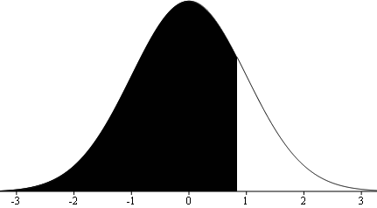
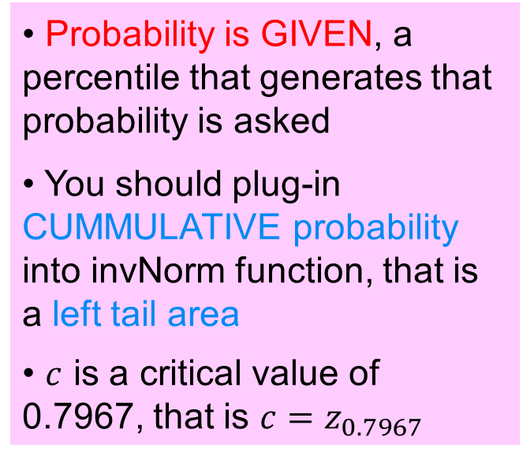


Normal Percentile
• Probability is GIVEN, a percentile that generates that probability is asked
• You should plug-in CUMMULATIVE probability into invNorm function, that is a left tail area
• $c$ is a critical value of 0.7967, that is $c=z_{0.7967}$
Suppose RV Z ~ N(0, 1), find the value of “c” such that
a) P(Z ≤ c) = 0.7967
Press 2nd and VARS [DISTR]
Scroll down to 3:invNorm(
Press ENTER
Enter 0.7967, 0, 1)
and press ENTER
to get the answer
The syntax for computing percentile c given cumulative prob P(X ≤ c)=p is invNorm(p, μ, σ)
$$c=0.83$$
0.7967
$$c=0.83$$

Slide 20
b) P(Z > c) = 0.2776
c) P(Z > c) = 0.0228
d) P(Z ≤ c) = 0.6217
Notes:
b) c=0.59 c) 2 d) 0.31

Slide 21
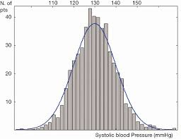
Application
Assume that systolic blood pressure follows a Normal distribution with mean of 130 and a standard deviation of 10.
a) What your reaction is if you read 160 or more on your friend’s SBP?
b) What is the systolic blood pressure level that only 5% of people exceed?

Slide 22
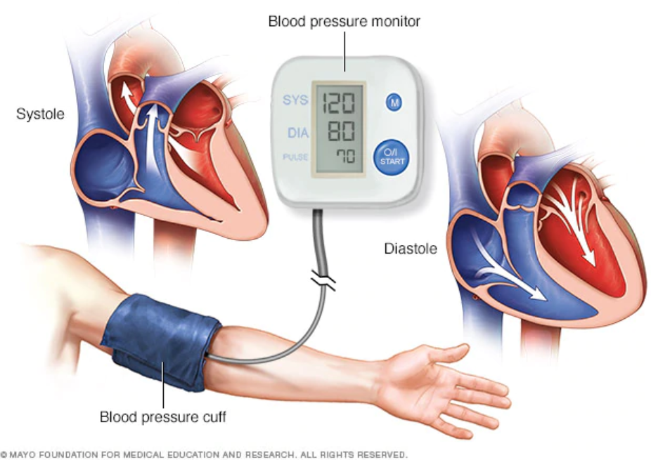
Practice Problems Part 1
1. Systolic blood pressure is assumed to follow a Normal distribution with mean of 108 and a standard deviation of 14. If an individual is selected at random from the population, find the probability that
a) the systolic blood pressure is below 112
b) the systolic blood pressure is above 127
c) the systolic blood pressure is between 104 and 118
d) The systolic blood pressure level that only 5% of the people exceed
2. Former NBA superstar Michael Jordan is 78 inch tall and WNBA basketball player Rebecca Lobo is 76 inch tall. Jordan is obviously taller by 2 in., but which player is relatively taller? Does Jordan’s height among men exceed Lobo’s height among women? Men have heights with a mean of 69.0 in. and a standard deviation of 2.8 in.; women have heights with a mean of 63.6 in. and a standard deviation of 2.5 in. (data is from the National Health Survey).
Notes:
Answers are provided in Ch5 Practice Problem Solutions.

Slide 23

Practice Problems Part 1
3. Suppose that a machine produces 325 mg aspirin tablets. Due to calibration issues, the actual Acetylsalicylic acid content of a pill follows a normal distribution with mean of 325 mgs and standard deviation of 7 mgs.
a) A pill is considered to be unacceptable for the market if it is off by more than 10 mgs from the concentration reported on the label. What percentage of the pills is acceptable for the market?
b) A pill is considered safe for the public if its concentration is at most 15 mgs above the concentration reported on the label. What percentage of the pills is unsafe for the public?
4. Let RV X be the IQ of a randomly selected person. Assume X ~ N(100, 16²). What is the probability that a randomly selected person has an IQ below 90? What is the minimum IQ of top 10% of the population?
Notes:
Answers are provided in Ch5 Practice Problem Solutions.

